Slide 1
Topic: Digital Citizenship and Online Safety

Slide 2
Objectives for today
Notices via Student Newsletter
To understand to risks online to your digital identity and how to better protect your digital identity
Explore the risks and dangers associated with digital relationships
To understand what propaganda is
To understand who can support you at The College

Slide 3

https://www.studentfirst.org.uk/student-newsletter

Slide 4

Your Digital Responsibilities
All College students are responsible for:
Keeping all user accounts safe
Ensuring you do not take images or video of others without their permission.
Using College IT systems and equipment appropriately an in accordance with the Acceptable User Agreement.
Notes:
College will:
Protect students from possible harm or distress caused by the misuse of IT systems and devices
Provide educational guidance on online safety and digital citizenship
Treat all reports of online bullying and harassment seriously

Slide 5


STAYING SAFE: Digital Security
So much of our lives is managed digitally that we all need to be aware of digital crime and take steps to protect ourselves.
https://vimeo.com/221408431
STAYING SAFE:
Keep your passwords private.
Make them longer by putting two unrelated words together. By adding numbers and special characters you can make them more complex.
Avoid having the same password for all of your devices and/or accounts.
Change your password if you think someone else knows it.
Do not respond to emails that ask for personal information. Organisations will not ask for personal information via email.

Slide 6

STAYING SAFE: Your Digital Identity
https://vimeo.com/44453166
Review your digital footprint. Google yourself and consider what others can see about you.
Think before you post anything online.
Never send intimate pictures of yourself to others or post them online.
Notes:
What does your social media content tell others about you?
When you post images, upload videos or add content online, you are sending messages about yourself to others. It is very important to consider the way you present yourself online.
Your personal and professional identity are at risk if you are not thoughtful about your online conduct. We leave a digital footprint when we post content online and these footprints are hard to erase.

Slide 7

STAYING SAFE: Digital Relationships
Remember that people are not always who they claim to be
Check, and regularly review, your social media privacy settings
Think carefully about what personal information you share about yourself online
Let trusted people in your life know who you are talking to online
Block and/or report individuals if their conduct is inappropriate
Notes:
Digital relationships: The digital world provides fantastic opportunities to connect with others both professionally and personally.
However, there are people who take advantage or these opportunities and use them to:
Exploit individuals financially
Groom individuals with the intention of causing them harm
Manipulate and radicalize individuals

Slide 8









What is propaganda?…
logs
Notes:
List 5 ways you would find our about the news?
Which method would you most prefer to use in order to access the news? And why?

Slide 9







Information, ideas, opinions or images, often only giving one side of the argument, that are broadcast, published, or in some way spread with the intention of influencing people’s opinions
Cambridge English Dictionary

Slide 10






To sell you something
To hide something from you
To make you do something
To influence of change your views and beliefs
Notes:
**Highlight the dangers of COVID-19 Disinformation and False Propaganda

Slide 11
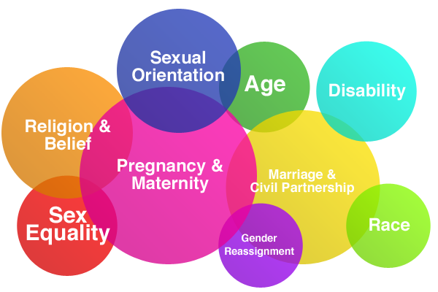
Bullying, Discrimination and Hate
Freedom of speech is an important part of our democratic society. The right to freedom of speech however is coupled with a social responsibility to others.
We all have a responsibility to challenge online hatred, intolerance, harassment and discrimination. People should feel safe and respected in the digital world.
Importantly, certain personal characteristics are protected by law. Inappropriate online conduct could result in police involvement and possible criminal charges. The protected characteristics are:

Slide 12

Our commitment:
We take bullying and harassment very seriously at Bournemouth and Poole College. We are an inclusive College and we champion equality and celebrate diversity.
If you experience any form of bulling or harassment, speak to your Personal Development Tutor, your Lecturer, or contact the Student Support team: wellbeing@bpc.ac.uk
STAYING SAFE:
Use your freedom of speech thoughtfully online.
Report content or communications that are hateful and/or violent.

Slide 13

Digital Health and Wellbeing
Have technology free time each day.
Avoid using technology late at night and do not keep your phone in your bedroom.
Reflect on how your use of social media and technology is making you feel. Is it making you happy? Is it damaging your self-image and confidence?
Notes:
Are you spending too much time on your digital devices? Think about the balance, especially in lockdown and learning online
The advances in mobile technology mean that we are rarely separated from our devices.
Spending excessive periods of time online can lead to problems with your health, relationships and work.
How do you know if you have a problem? The following may be signs that you spend too much time on your digital devices:
ongoing headaches, eye strain and sleep disturbance
online activities interfering with your health
withdrawal from face-to-face contact with friends and family
attributing more importance to your online activities and contacts than anything else
decline in your academic performance at college.

Slide 14



If you need support with…
Emotional & Mental Health Support
Welfare support
Counselling
Financial Support
Domestic abuse and violence
Homelessness/housing
Bullying, both physical and non-physical
Discrimination and hate crime
Substance misuse
Anything else related to your wellbeing
Contact the Student support team:
Speak to: your Personal Development Tutor (PDT), or anyone in the Student Support team…look out for our rainbow lanyards!
Self-referral to speak to a Wellbeing or Mental Health Coach: Go to the Student First Website under “Our Advice” fill out the Self-referral form.
https://www.studentfirst.org.uk/our-advice
Email: wellbeing@bpc.ac.uk
External Support services:
Papyrus - help and support surrounding suicide
Samaritans - provides confidential non-judgmental support
KOOTH - online mental health community with Live chat support
Calm - help and support surrounding suicide
Talk To Frank - support and advice on Drugs
Child Line - confidential where you can talk about anything
NHS 111 - health support by phone and online
Dorset Police - report a crime
Sexual Health - Local service for Sexual health and advice
Money Advice Service - free impartial advice on finances

Slide 15

RECAP
Our values are important because they help us to grow and develop. They help us to create the future we want to experience.
Remember DRIL:
DEMOCRACY
RESPECT AND TOLERANCE
INDIVIDUAL LIBERTY
RULE OF LAW

